Slide 1



 | Volunteer Agreement
 | Thank you for your interest in Volunteering with TYPE ORGANISATION’S NAME
 | We hope you enjoy volunteering with us and feel part of our team.
 | This Volunteer Agreement says what you can expect from us. It also says what we hope from you.
Insert your logo here

Slide 2


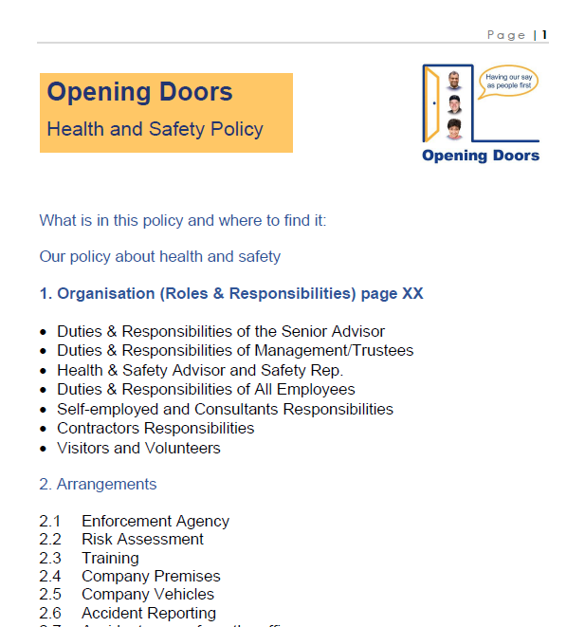


Volunteer Commitment – as a volunteer you agree to:
 | Work in line with the values of TYPE ORGANISATION’S NAME
 | Follow the rules and policies and procedures we share with you.
 | Be reliable and arrive at the agreed time.
 | Tell us if you cannot come to do your volunteering. Please give us as much notice as possible.

Slide 3




Health and Safety – as a volunteer you agree to:
 | Follow all our health and safety policies and procedures. Follow the steps on all risk assessments.
 | Report any accidents or near-misses straight away to the paid staff member you are working with.
 | The paid staff member will take responsibility for making decisions about emergency support and completing reports. They may ask you for a report too.

Slide 4



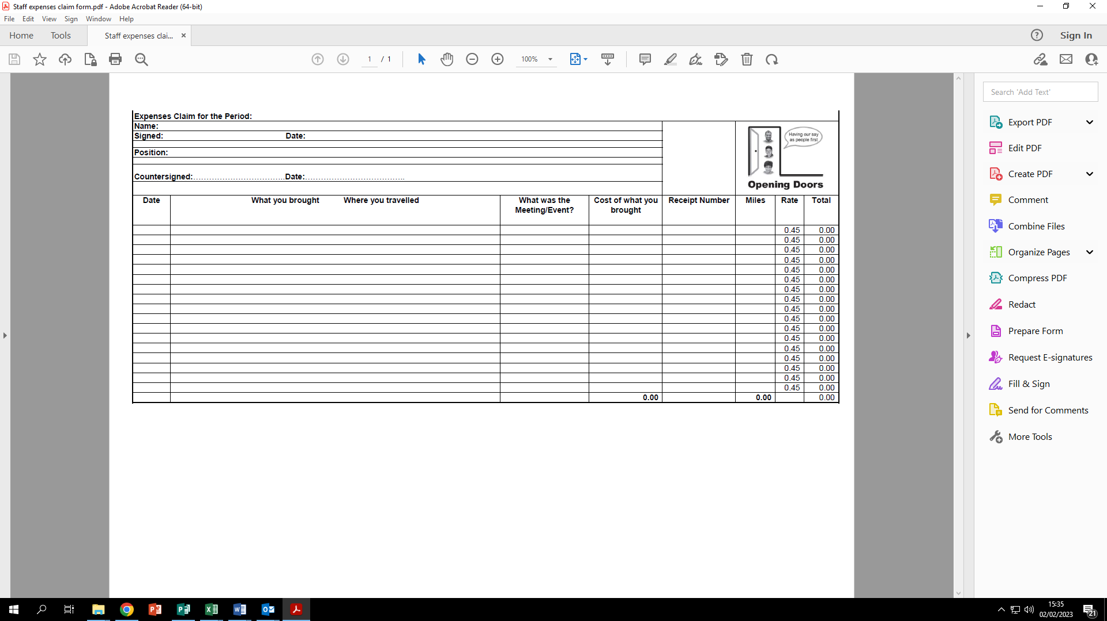

Volunteer Benefits – INSERT ORGANISATION will:
 | Give you a full induction and any training you need for your volunteering role.
 | Help you to develop new skills and gain experience.
 | Give regular supervision and support to help you in your role.
 | Pay you back for any travel and other agreed expenses.

Slide 5





Ending your volunteering role
 | We understand you may need to stop volunteering with us for lots of different reasons.
 | We will talk to you before you leave. We want to know how you found your time volunteering with us.
 | TYPE YOUR ORGANISATION’S NAME may ask you to stop your volunteering role if there are concerns about your work or your behaviour.

Slide 6



Signing this agreement
I have read and agree to this volunteer agreement. I understand this agreement is not a contract of employment.
Sign your name here ⬇ | Write the date here ⬇
Signing for TYPE ORGANISATION’S NAME ⬇ | Write the date here ⬇

