Slide 1


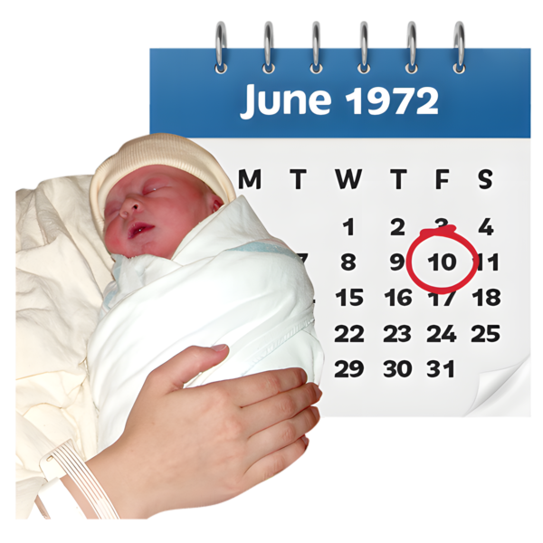

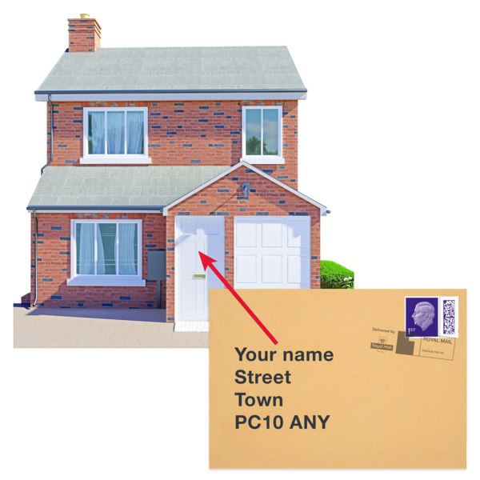
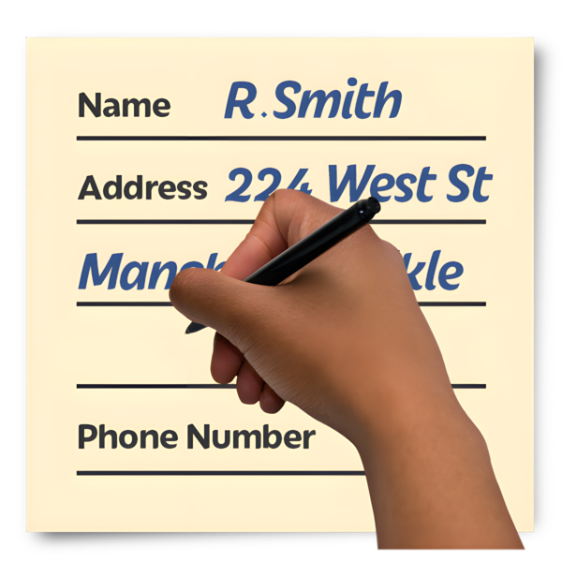
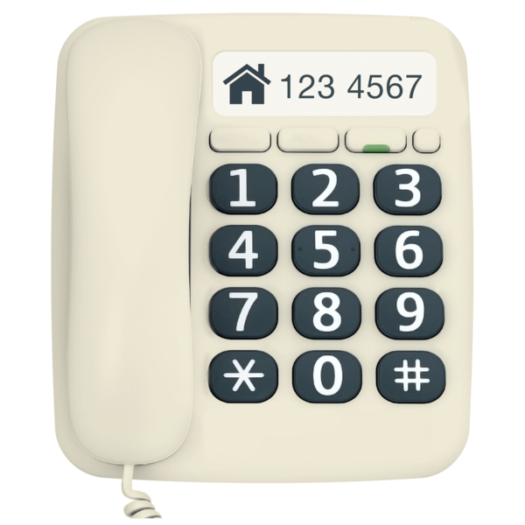






Put your logo here
Volunteer
Application Form
This form helps us find out more about you and how you may be able to volunteer with us.
The information will be kept confidential and stored safely at [type organisation name here].
 | Your name
 | Your date of birth The date, month, year you were born |  | ____ / ___ / ___
 | Your address
 | Your phone number (s)
 | Your email address
 | What is the best way to get in touch with you?
 | By letter | By phone | By email

Slide 2















 | Do you have a driving licence ? Please tick 1 answer | Yes | No
 | Do you own a car? Please tick 1 answer | Yes | No
 | What volunteer roles are you interested in?
 | What time do you have available for volunteering? Please tick the days and times you want to offer
 | How did you hear about us?
am | pm | am | pm | am | pm | am | pm | am | pm | am | pm | am | pm

Slide 3






 | Tell us about yourself – things like hobbies and jobs
 | What skills or experience can you share with us? This could be things like computer skills, photography, answering phones, making videos, art etc
 | Are there any adjustments you need to volunteer? Please tell us what you need to take part and anything about your health or disability we need to know.

Slide 4




 | Please give the name and address of 2 people we can contact for a character reference. This is called a referee and is where someone says if they think you would make a good volunteer. These people should not be family members.
 | Do you have a criminal record? If so please give details – we need to know about any unspent convictions you have ⬇
 | [insert organisation name] uses the disclosure and barring service to help decide if people are safe to be volunteers with us. We use the DBS Code of Practice and promise to treat everyone applying for voluntary work fairly. We have a policy about ex-offenders volunteering.
When you have finished this form return it to [insert all the details about where and how to return this form]
Referee 1 | Referee 2
Name | Name
Address | Address
Phone number | Phone number

